Slide 1
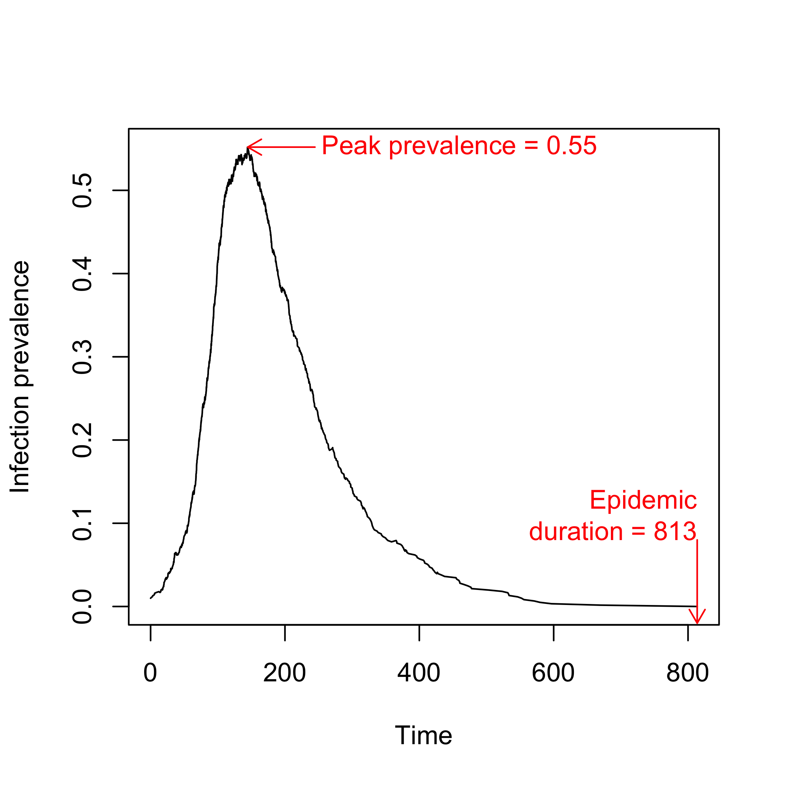
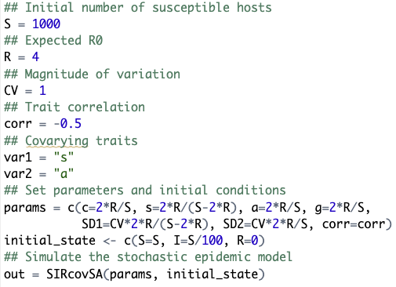
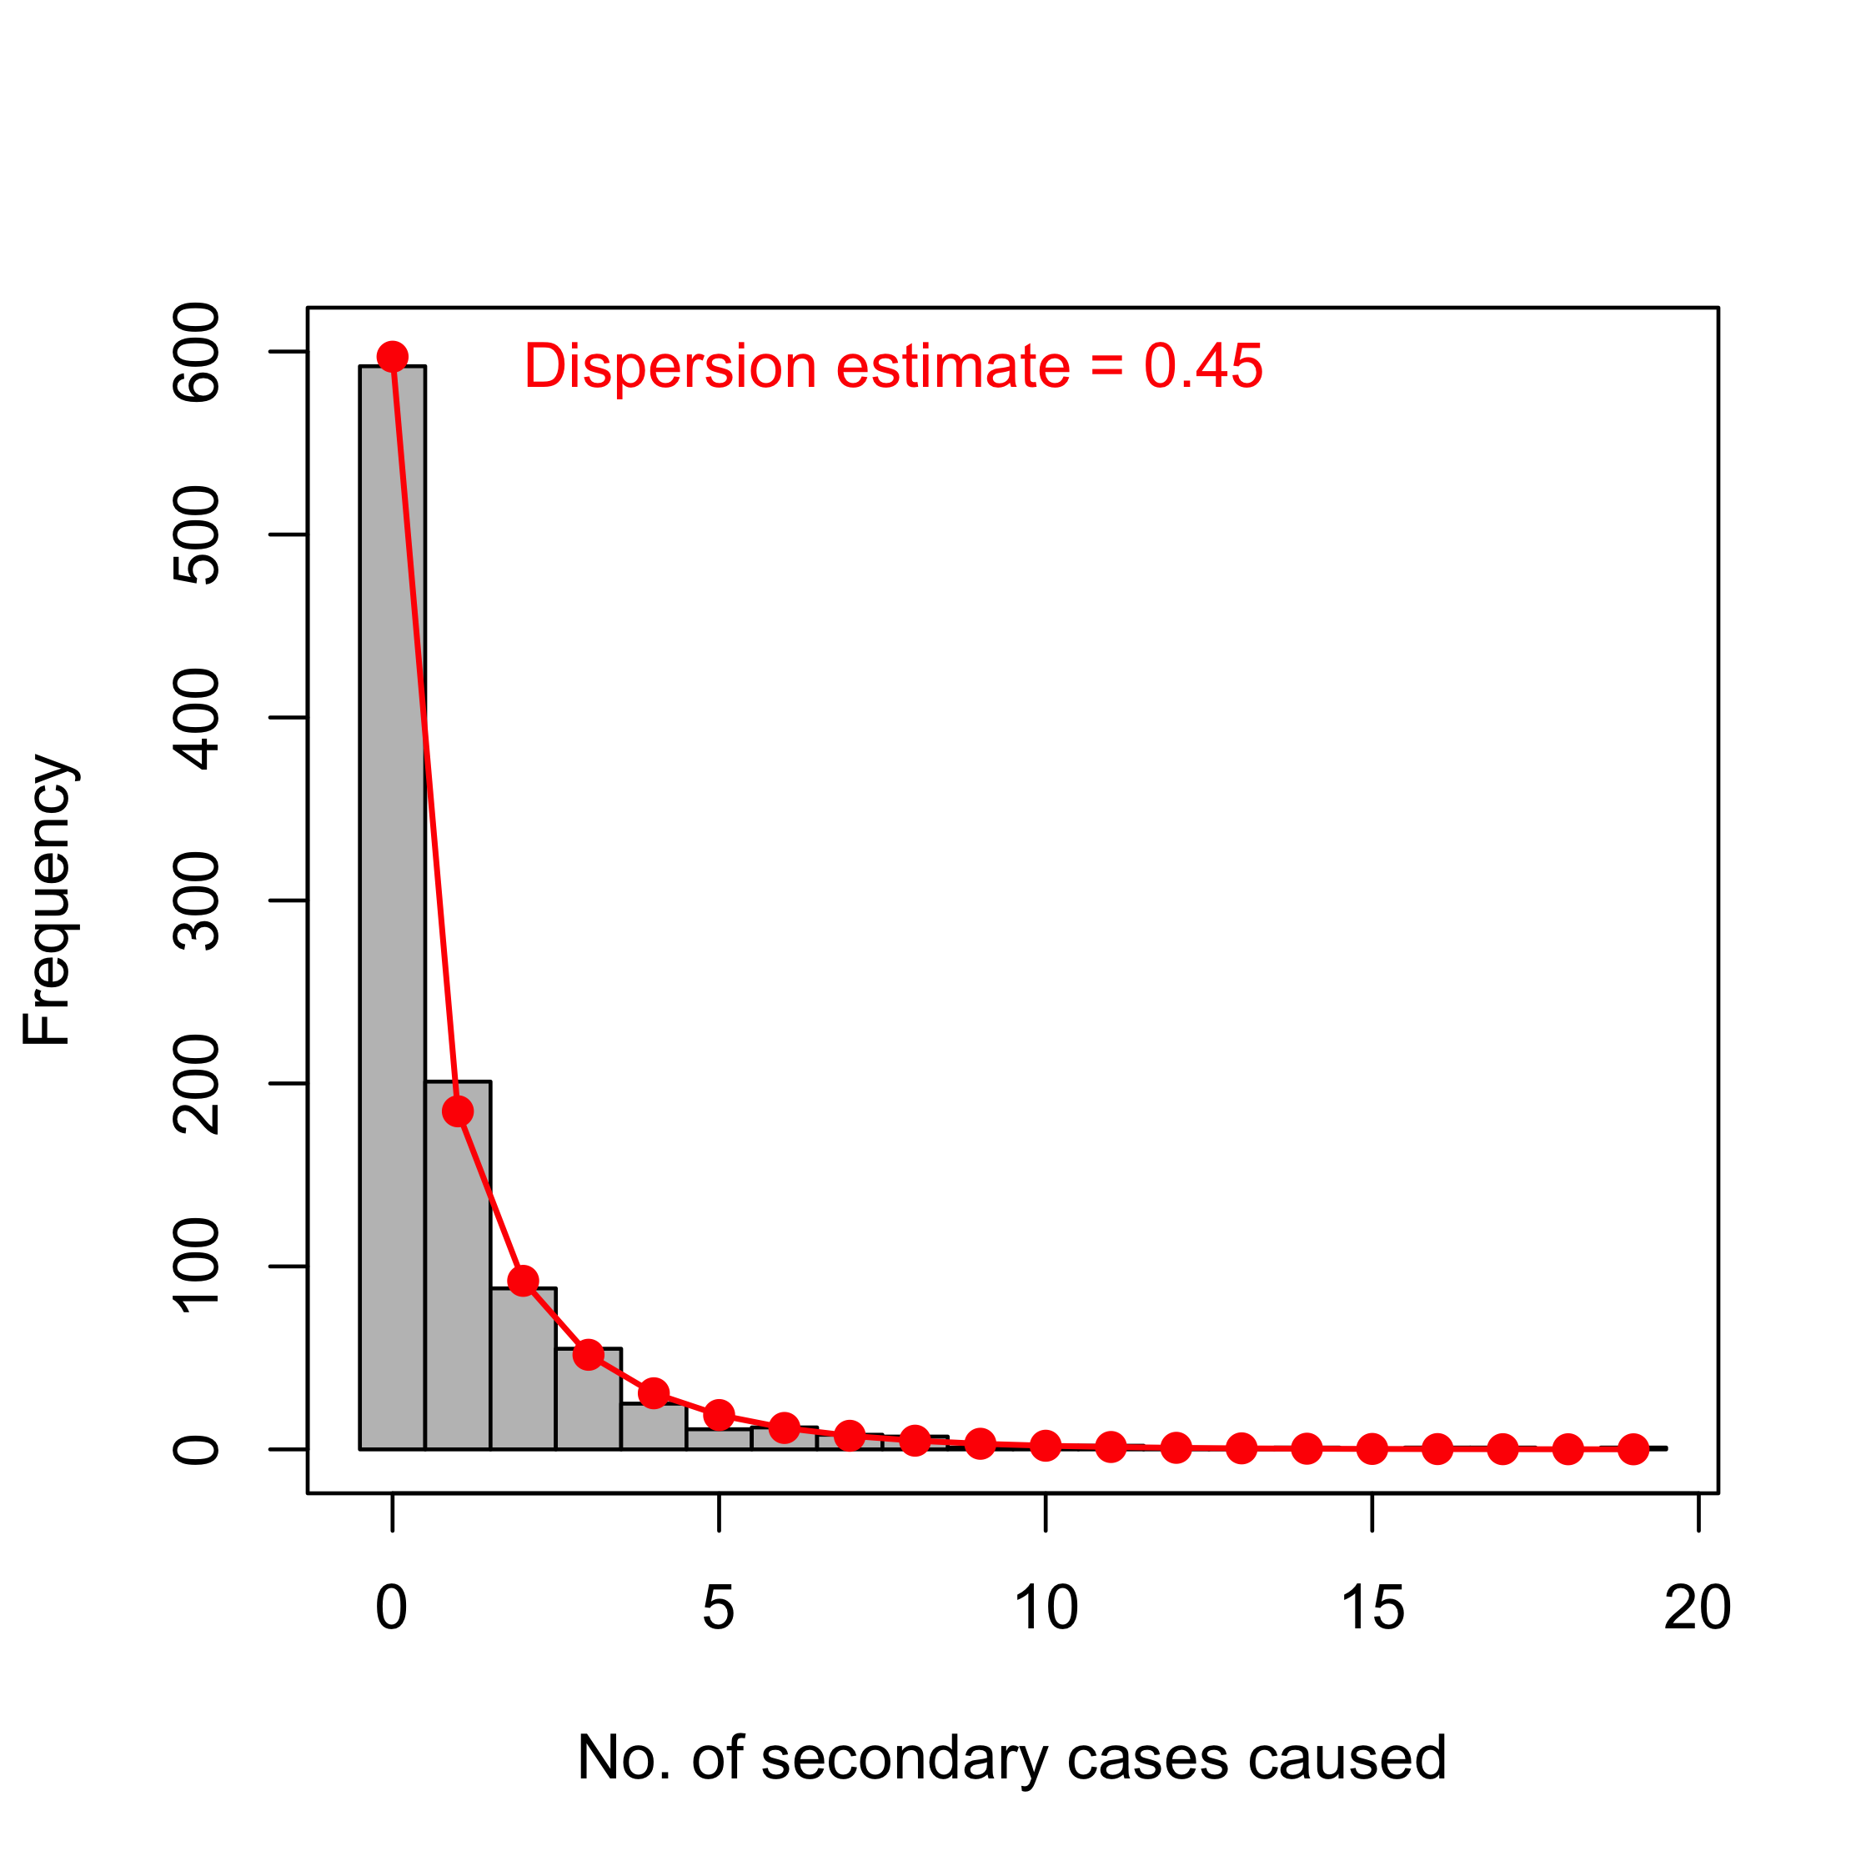
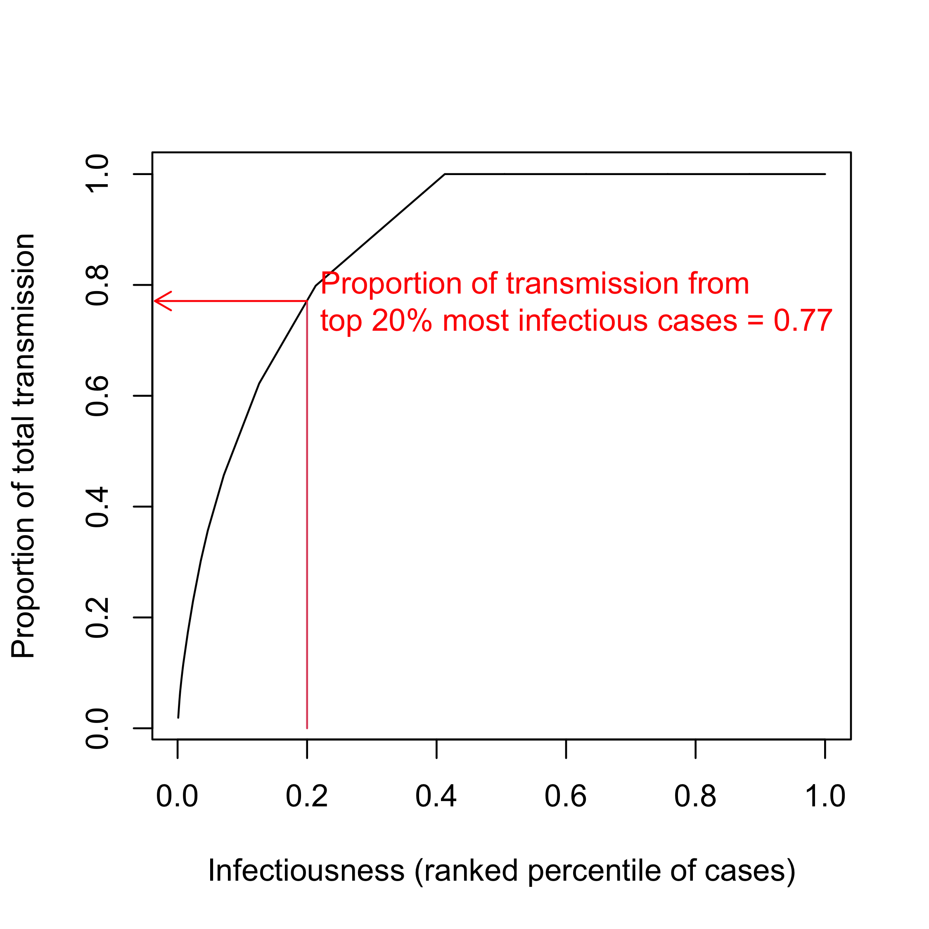
1. Choose simulation parameters and run the stochastic epidemic model.
2. Plot the observed epidemic curve and calculate the peak prevalence and epidemic duration.
3. Fit a negative binomial distribution to the observed number of cases caused by each infection and estimate the dispersion.
4. Rank each infection by infectiousness and calculate the proportion of transmission from the most infectious 20% of cases.

